Slide 1
Practical malware analysis
Chapter 0-1
Presenter
Soolin Kim

Slide 2
What is Malware?
Malware is defined as software designed to disrupt, damage, or gain unauthorized access to systems.
  any software that harms users, systems, or networks
Classification is based on behavior and impact rather than names or labels.
Modern malware often exhibits hybrid characteristics.

Slide 3
The Goals of Malware Analysis
To define malware and explain the objectives of malware analysis.
To classify major malware types and threat models.
To distinguish static and dynamic analysis methodologies.
To apply fundamental static analysis techniques using industry-standard tools.
To interpret PE file structures and extract security-relevant artifacts.

Slide 4
Common Malware Types
Backdoors enable unauthorized remote access and command execution.
Botnets consist of multiple compromised hosts controlled by a C2 infrastructure.
Downloaders are specialized in retrieving and installing additional malware.
Information-stealing malware exfiltrates sensitive data from infected systems.
Launchers execute secondary malicious payloads using stealth techniques.
Rootkits conceal malware presence to evade detection.
Scareware manipulates user fear to induce financial gain.
Spam malware abuses infected hosts for mass message distribution.
Worms and viruses propagate autonomously across systems.

Slide 5
Outputs: Host-Based vs Network Signatures
Host-based indicators derived from system artifacts
  Such as files, registry keys, services, processes
Network-based indicators derived from traffic behavior
  IPs/domains/URLs, ports, traffic patterns
Contextual intelligence supporting incident response

Slide 6
Analysis Approaches
Static analysis: examine without execution
  Basic: quick metadata and clues
  Advanced: disassembly and reverse engineering
Dynamic analysis: execute and observe behavior
  Basic: sandbox observation
  Advanced: debugger-based inspection

Slide 7
Basic Static Analysis Techniques

Slide 8
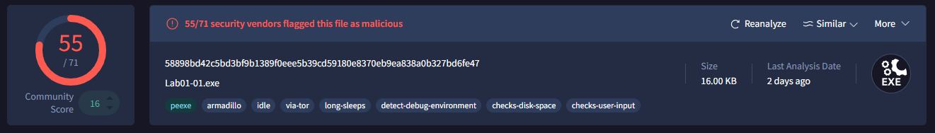
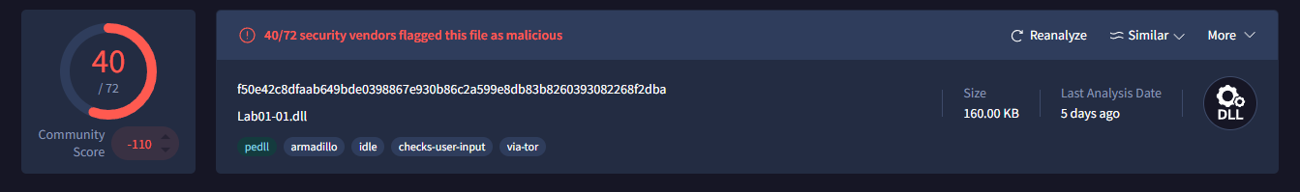
Antivirus Scanning (VirusTotal)
Scan with multiple engines to check prior identification
Useful early reference, not a final decision
Rare/targeted malware may evade signatures

Slide 9
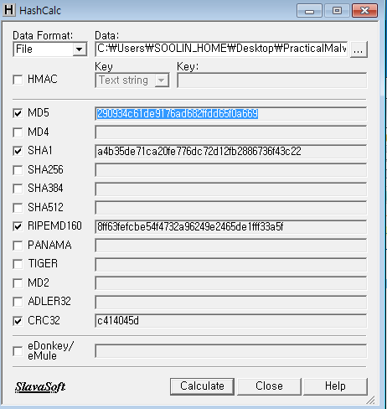
Hashing for Identification
Common algorithms include MD5, SHA-1 or SHA-2 as a file fingerprint
Hash values uniquely identify binary artifacts.
Hashes facilitate sample tracking and information sharing.

Slide 10

Md5deep vs WinMD5 Calculator
Md5deep (CLI): fast, scalable, script-friendly
WinMD5 Calculator (GUI): simple, interactive, single-file checks
Both produce the same MD5 output
But…

Slide 11
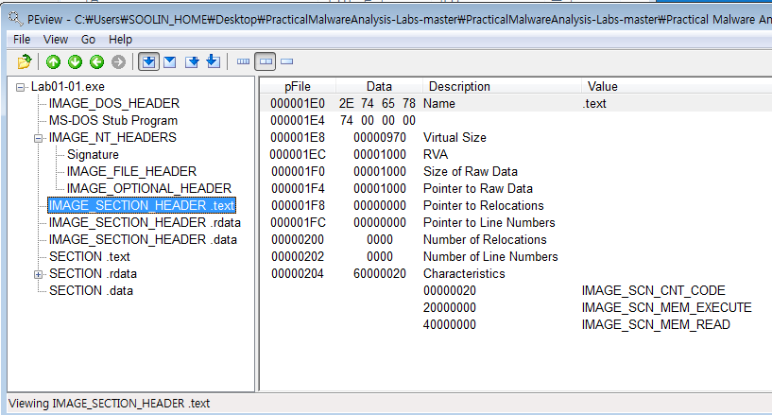
PE Format: Structure
PE = Windows executable format
Composed of headers + sections
Headers store metadata needed by the Windows loader

Slide 12
Common PE Sections
.text: executable instructions
.rdata: read-only data, import/export info
.data: global writable data
.rsrc: resources (icons, dialogs, strings)
Unusual section names or size mismatches can indicate packing

Slide 13
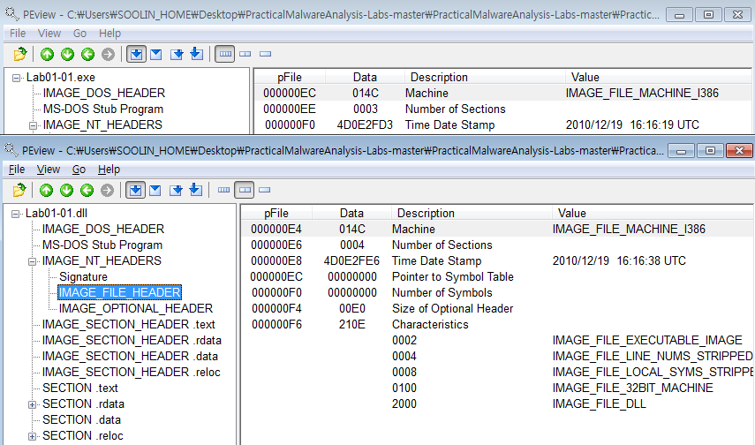
Key Header Fields
Time Date Stamp: compile time (may be forged)
Subsystem: GUI vs Console
Section sizes: Virtual Size vs Raw Size

Slide 14
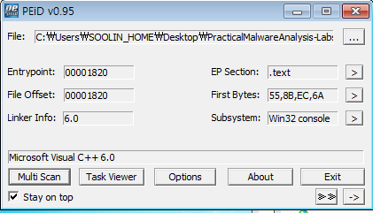
Packed and Obfuscated Malware
Obfuscation techniques obscure program logic.
Packing compresses or encrypts payloads for runtime unpacking.
Indicators include sparse strings and minimal import tables.

Slide 15
Packer Identification (PEiD)
Detect packer/compiler signatures
Helpful for quick triage and unpacking decisions
Some packers (e.g., UPX) may be unpacked easily

Slide 16
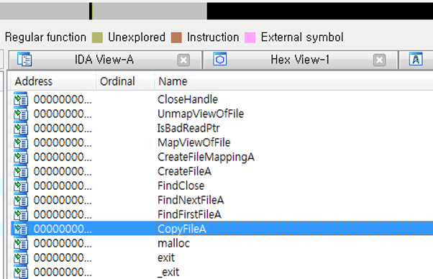
Imports: Inferring Capabilities
Imports list external DLL functions used by the program
Key clue for functionality inference
  Example: CopyFile → likely download behavior

Slide 17
Exports: What the Binary Provides
Exports are functions provided to other programs
Common in DLLsExport names can hint at purpose, but may be misleading

Slide 18
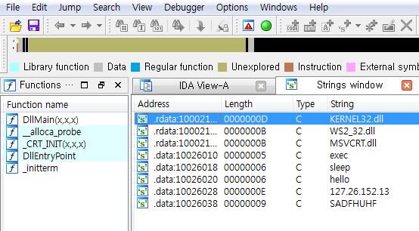
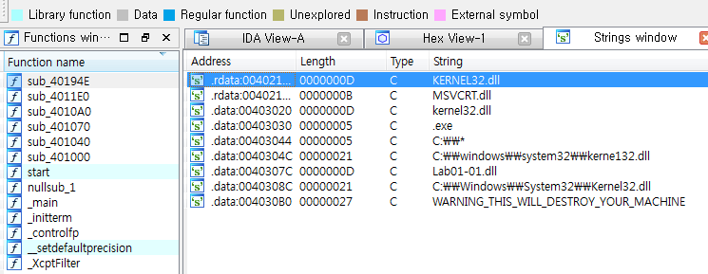
Strings Analysis: Why It Matters
Embedded strings provide insight into program functionality.
  APIs, DLLs, IPs, URLs, messages
Error messages can expose intent and dependencies
Context-aware interpretation is essential to avoid false conclusions.

Slide 19



Tools for PE Analysis
IDA Free
  Analysis of imported DLLs and API functions; inspection of the .rsrc section
PEiD
  Detection of packers and obfuscation
Peview
  Examination PE headers and section metadata

Slide 20
Lab 01
1. Upload the files to VirusTotal and view the reports. Does either file match any existing antivirus signatures?
2. When were these files compiled?
3. Are there any indications that either of these files is packed or obfuscated?
If so, what are these indicators?
4. Do any imports hint at what this malware does? If so, which imports
are they?
5. Are there any other files or host-based indicators that you could look for
on infected systems?
6. What network-based indicators could be used to find this malware on
infected machines?
7. What would you guess is the purpose of these files?

Slide 21
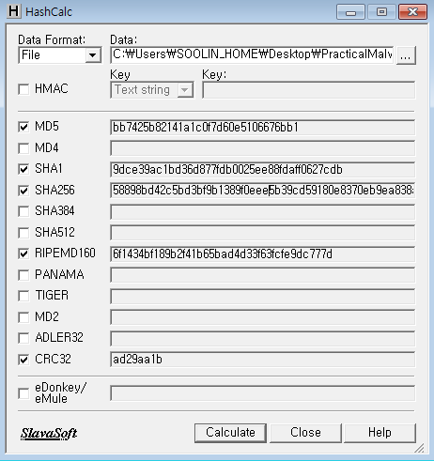
Does either file match any existing antivirus signatures?

Slide 22
When were these files compiled?

Slide 23
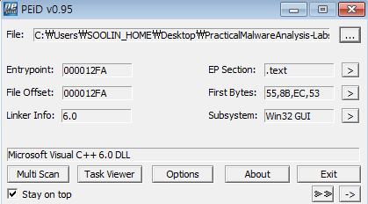
Are there any indications that either of these files is packed or obfuscated?

Slide 24
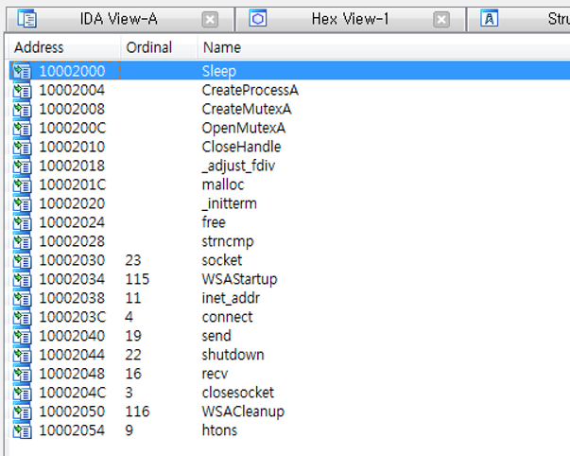
Do any imports hint at what this malware does?

Slide 25
Are there any other files or host-based indicators that you could look for on infected systems?

Slide 26
What network-based indicators could be used to find this malware on infected machines?

Slide 27
What would you guess is the purpose of these files?
The CreateProcess and Sleep functions are commonly used in backdoor malware.
The presence of the exec string suggests execution of backdoor commands via CreateProcess.
The sleep string indicates functionality to pause execution, likely used to control backdoor activity timing.
Strings resembling IP addresses suggest network communication used by the backdoor.

Slide 28
QnA

Slide 29
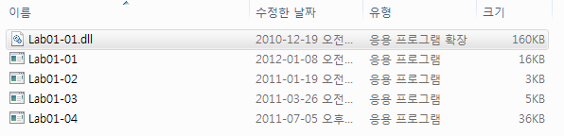
Notes:
https://naado.tistory.com/39
툴들

Slide 31
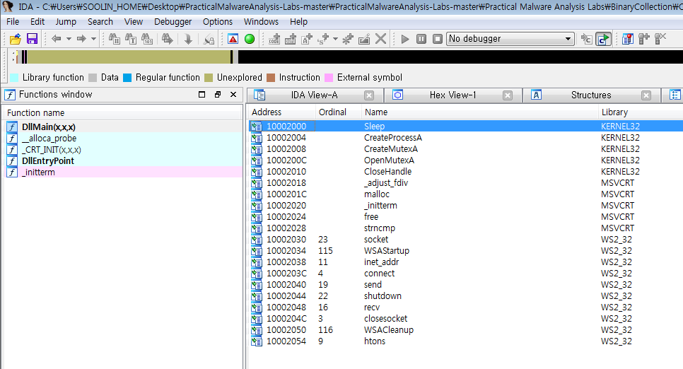

Slide 32
